Slide 1
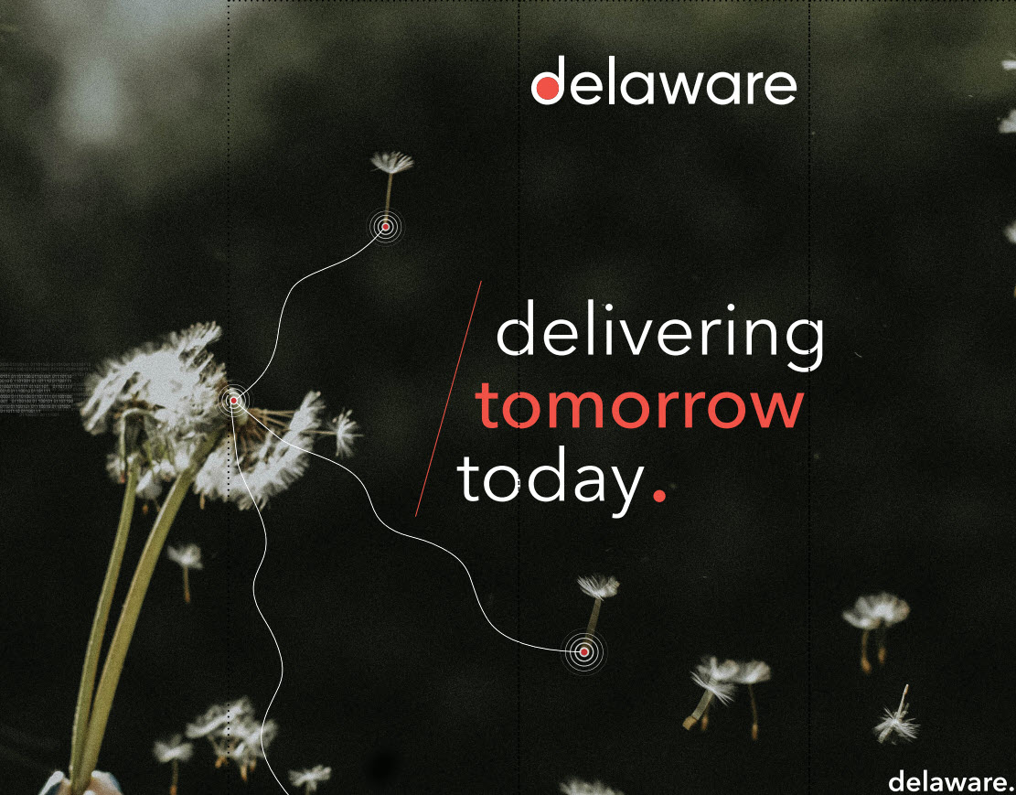
My internship At
by: Lyva Van Damme

Slide 2

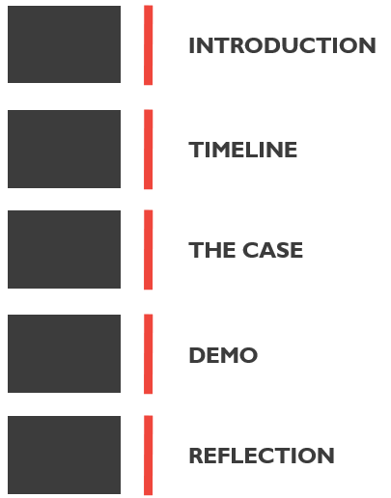
Agenda

Slide 3
Introduction
timeline
The case
Demo
Reflection

Slide 4
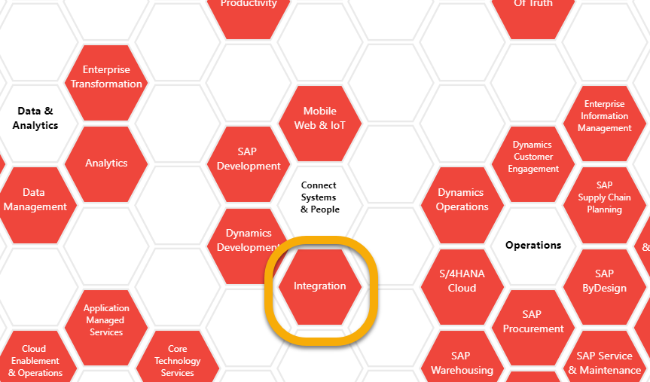
Intern at delaware
Introduction
Team SAP integration
CPI
PI & PO
Under the guidance of Pauwelyn, Nicolas

Slide 5
timeline
Introduction
The case
Demo
Reflection

Slide 6
Timeline
internship
W 1-3
W 3 - 5
W 6 - 8
W 9 - 14
SAP help

Slide 7
The case
introduction
Timeline
Demo
Reflection

Slide 8



core
The idea
Personalized data
Transaction history
Top sold products

Slide 9
To DELIVER
The idea
1
2
3
Personalized recommendations
Integrated in C4C
Sales & Marketing strategies

Slide 10

Architecture

Slide 11







Slide 12
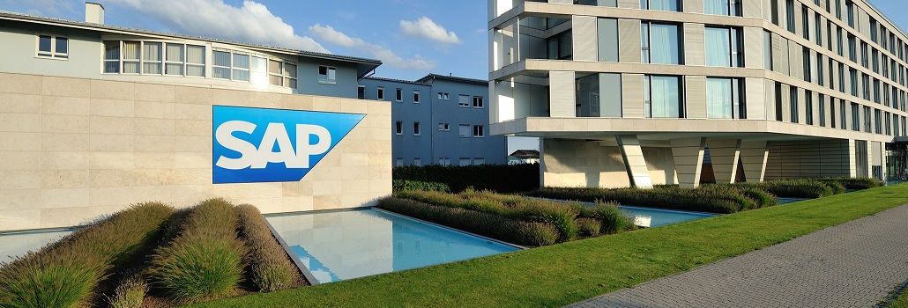
Close up
Architecture
Machine learning
SAP HQ
APL library
PAL library
Social Network Algorithm
Apriori Algorithm

Slide 13
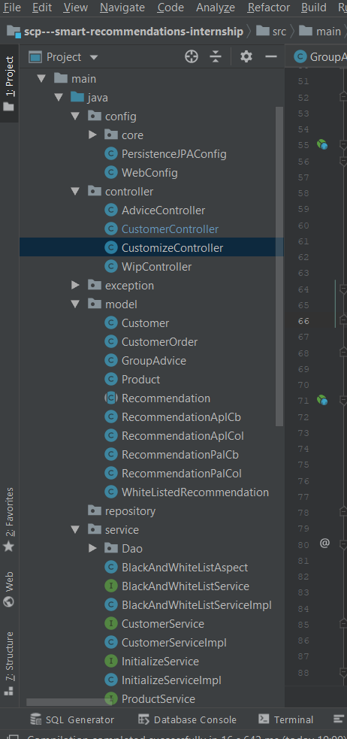
Close up
architecture
For the engine
Customer
Product
Transaction
recommendation
collaborative
Content based
IDE: intellJ

Slide 14

Funtionality

Slide 15
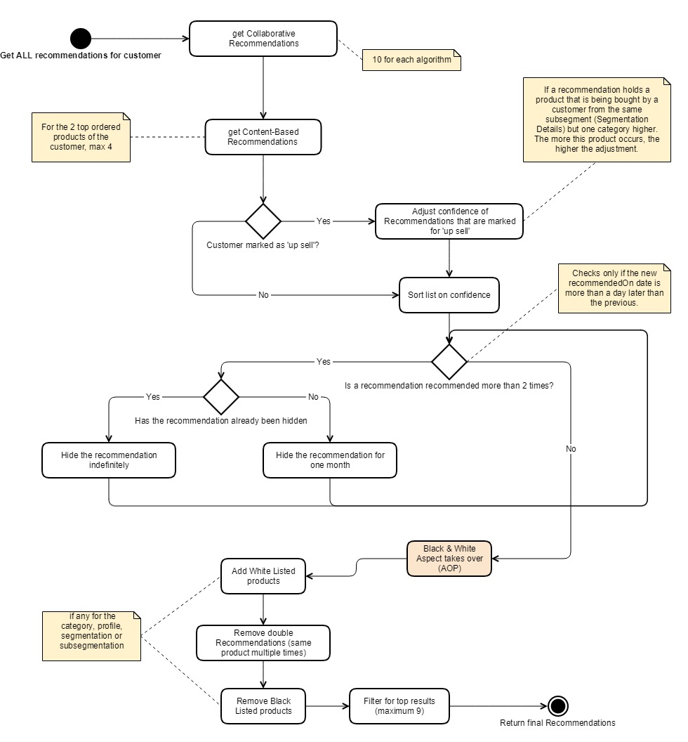
Recommendations
Functionality
One list
Personalized for the customer
Extra’s
Tracking, upselling, hiding, …

Slide 16
extentions
Functionality
Strategies
Fully Integrated
Black & whitelist products
In the C4C platform
External apis
Night jobs
For managing new data
Success rate & recommendations

Slide 17

security
Functionality
Embedded with application URL
Strategies accessible for managers
APIs
Token
Work in progress
credits: Pexels

Slide 18
demo
introduction
Timeline
The case
Reflection

Slide 19
Reflection
introduction
Timeline
The case
Demo

Slide 20
Internship
My final thoughts
I have learned…
Business side
Teaching myself
Company mindset
How to apply for a job
… not enough

Slide 21

IT’S TIME FOR A NEW STORY
credits: Pexels

Slide 22
YOU
THINK

